Slide 1
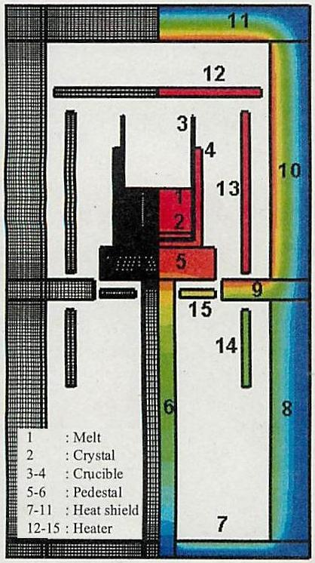
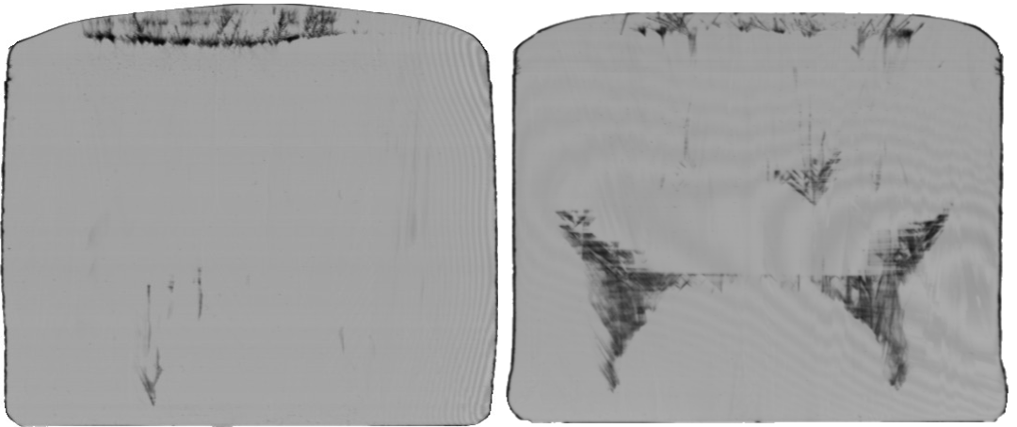
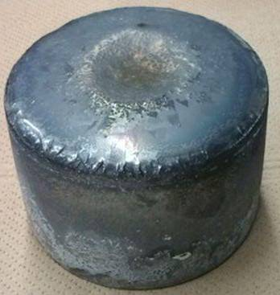
Precipitation behavior of light element impurities in cast silicon
BP01 / BIAMS 22-26 June 2014
J.Y. Li, T. Sekiguchi, R.R. Prakash, K. Jiptner, Y. Miyamura, H. Harada, NIMS
K. Kakimoto Kyushu Univ. A. Ogura Meiji Univ.
10 cmφ ingot
Light element precipitates
Butterfly
1
Notes:
1

Slide 2
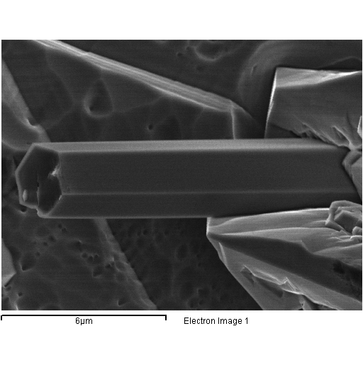
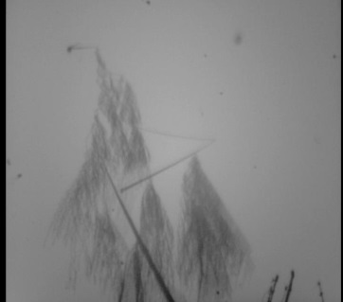
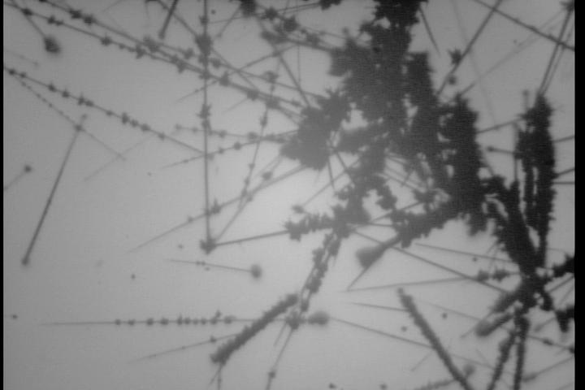
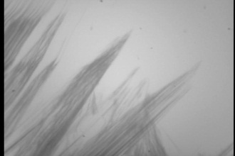
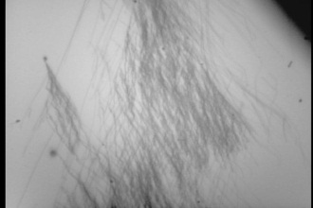
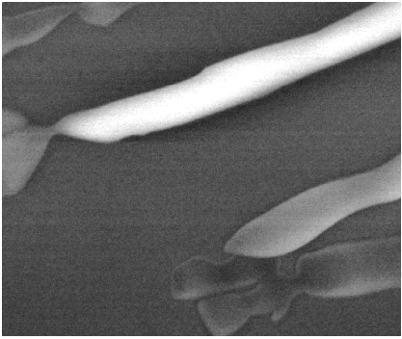
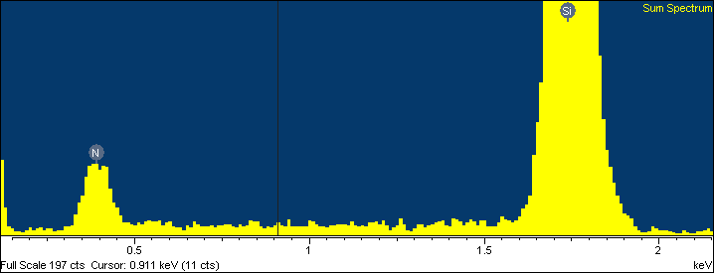
Morphology : fiber, filament
Chem. nature : Si₃N₄
N
Si
500μm
500μm
C
N
500μm
500μm
N
Origin : anomalous convection
2

