Slide 1
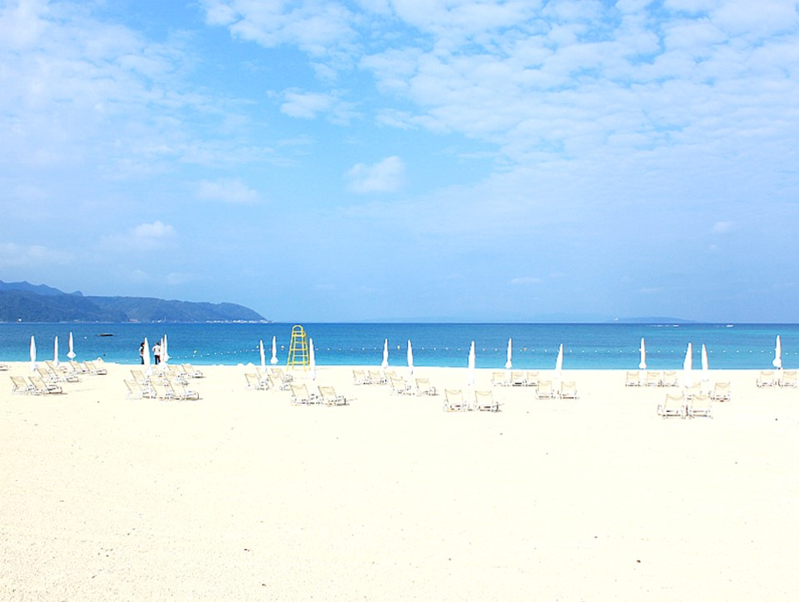
EDGE 2017
Important dates:
Abstracts due: January 22 31, 2017
Notification of acceptance: February, 2017
Registration deadline: March 15, 2017
Accommodation booking: March 15, 2017
Meeting: May 14-19, 2017
Papers for proceedings: May 31, 2017
Scientific Chairs:
Odile Stephan and Peter Crozier
Organizing Committee:
Michel Bosman, Peter Crozier, Joanne Etheridge, Koji Kimoto, Gerald Kothleitner, Lena Kourkoutis, Ondrej Krivanek, Quentin Ramasse, Odile Stephan, Peter van Aken, Maria Varela del Arco, Benedicte Warot-Fonrose
A limited number of scholarships for Ph.D students and post-docs will be available.
May 14 (Sun) - 19 (Fri) 2017
JAL Okuma Resort
Okinawa, Japan
E
7
D
1
G
E
2
0
"Enhanced Data Generated by Electrons"
8th International Workshop on Electron Energy-Loss Spectroscopy (EELS) and Related Techniques
http://www.nims.go.jp/EDGE2017/

Slide 2
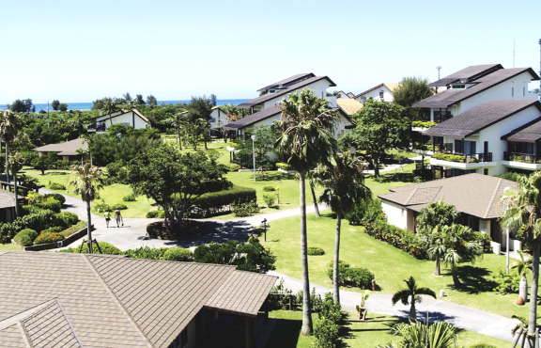
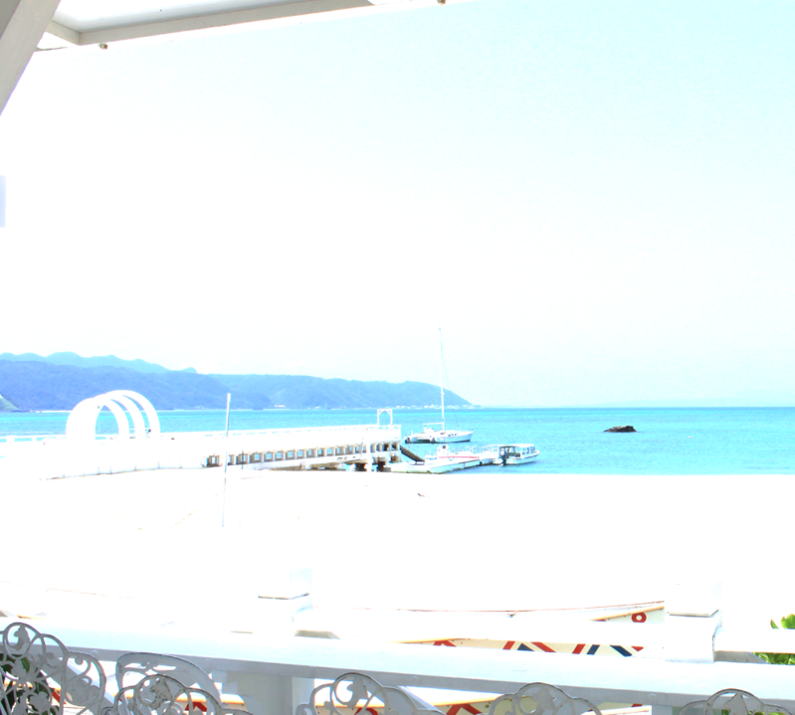
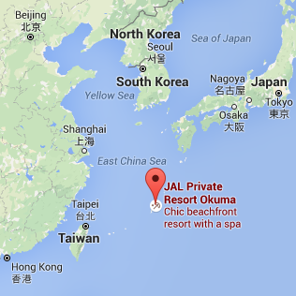
Meeting schedule:
Gordon Conference-style, with talks and posters in the mornings and evenings, and afternoons free for informal discussions.
Meeting venue:
JAL Okuma is in Northern Okinawa. The resort artfully blends Japanese traditional design with modern conveniences, and offers excellent amenities.
http://www.jalokuma.co.jp/en/
Travel Information
Okinawa is a Japanese island in the East China Sea, with direct flights from Tokyo, Osaka, Seoul, Shanghai and Hong Kong, and other major airports.
Topics and invited speakers
Plenary Lecture
Sumio Iijima (AIST/Meijo U., Japan)
Very High Energy Resolution EELS
Maureen Joel Lagos (Rutgers U., Piscataway, USA)
Kazu Suenaga (AIST, Tsukuba, Japan)
Spectroscopic Imaging
Gerald Kothleitner (U. of Graz, Austria)
Instrumentation Advances
Florent Houdellier (CEMES-CNRS, Toulouse, France)
Tracy Lovejoy (Nion, Kirkland, USA)
Damien McGrouther (U. of Glasgow, UK)
Naoya Shibata (U. of Tokyo, Japan)
Theory
Javier Aizpurua (CSIS, Spain)
Les Allen (U. of Melbourne, Australia)
Lorenzo Pardini (Humboldt U. of Berlin, Germany)
Materials and Biological Applications
Gianluigi Botton (McMaster U., Hamilton, Canada)
Lena Kourkoutis (Cornell University, USA)
Beyond Traditional Spectroscopy
Johannes Jobst (Leiden U, Netherland)
Claus Ropers (U. of Göttingen, Germany)
Luiz Tizei (Université Paris Sud, France)
Okinawa

